Slide 1
A story on going back to school after lockdown
Created by Rebecca Duffus, The Autism Service, Cognus Limited
Adapt for your own school using your images, appropriate year group, tutor group or subject.

Slide 2
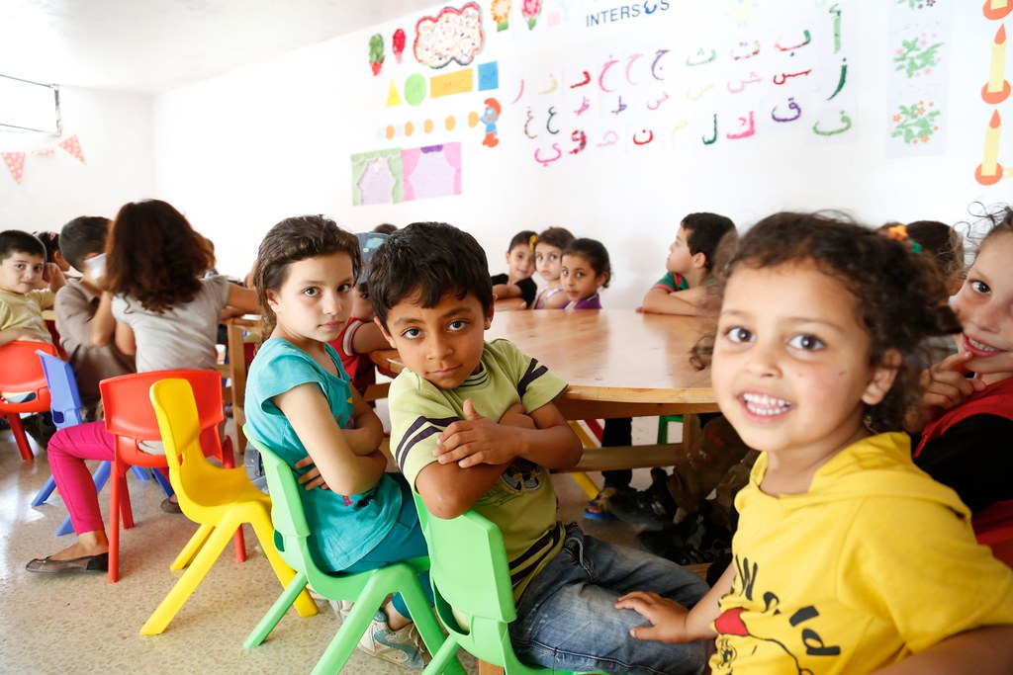
I am in year … in M ….’s class at ……. School.

Slide 3
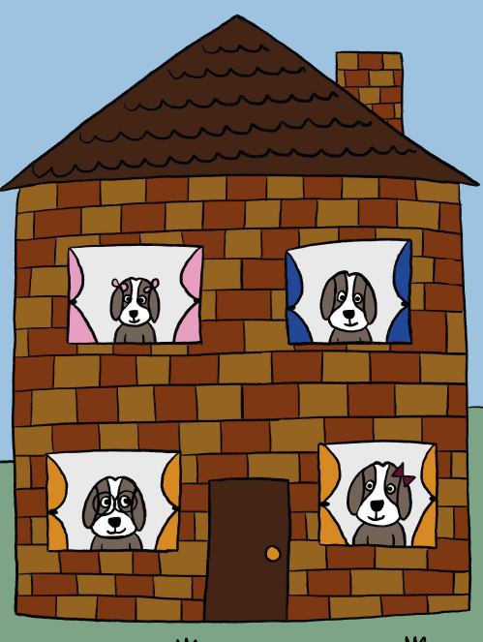
We started year … in a classroom.
Because of covid-19 we have spent some time at home, to try and stop the spread of the virus.
We tried to do our school work at home and did different activities.

Slide 4
What is coronavirus or Covid-19?

Slide 5
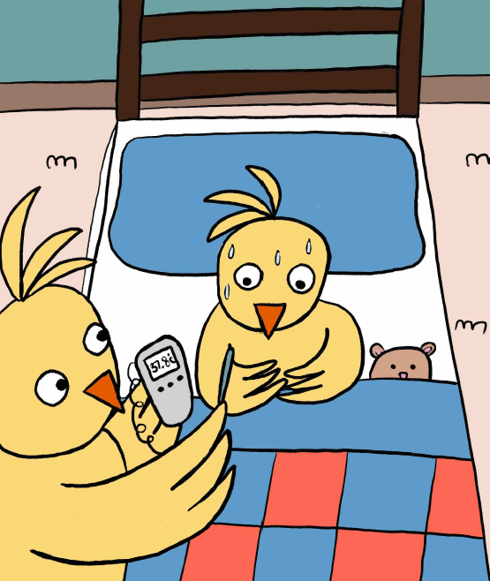
Covid-19 is a new type of coronavirus that makes people feel unwell.
Most people who have Covid-19 may feel like they have a cold or the flu.
After a few days or weeks they will feel well again.

Slide 6
A very very small number of people who have Covid-19 may become very unwell. They may need to go to hospital so the doctors can try to help their bodies get rid of the virus.
This does not usually happen to young people like us.

Slide 7
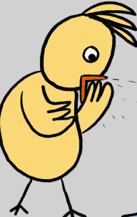
Viruses are usually caught by people touching something that has the virus on, and then touching their face.
Sometimes people catch it by being too close to someone else who has coughed or sneezed.

Slide 8
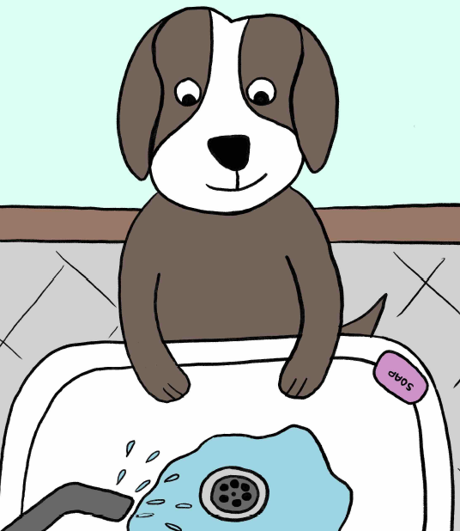
Viruses are so small, we cannot see then.
Its important we wash our hands often with soap and warm water – this gets rid of the virus and keeps us healthy.
Our teachers will remind us when we need to do this.

Slide 9
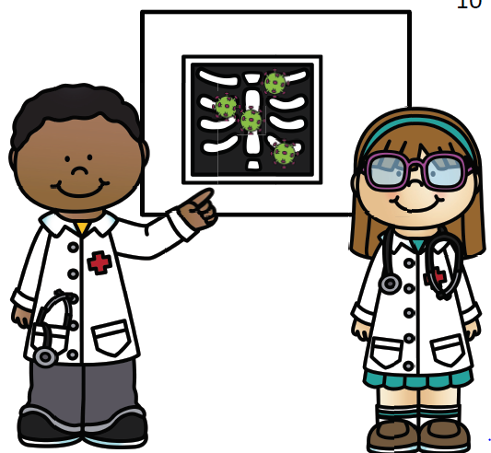
Because covid-19 is a new virus, doctors and scientists are still trying to find ways to treat and stop the virus.
While we wait for this to happen, there are some important things we need to do.

Slide 10
What has changed?

Slide 11
The government have recommended that some children can come back to school.
This means some children will be going back but their brothers or sisters may be staying at home.

Slide 12
This is so that there are not too many people there.
Some things in school will be different.

Slide 13
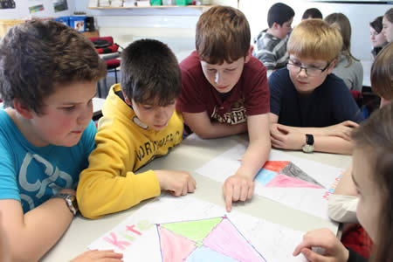
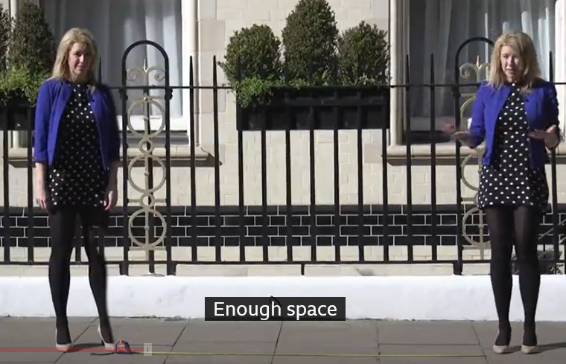
We need to try and practice ‘social distancing’ which means we should try to stay around 2 metres away from anyone else, apart from the people we live with.

Slide 14
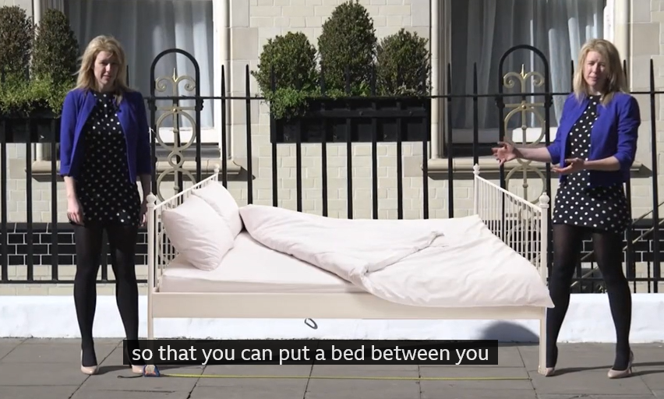
2 metres is about 3 big steps.
Or you can imagine the length of a bed.

Slide 15
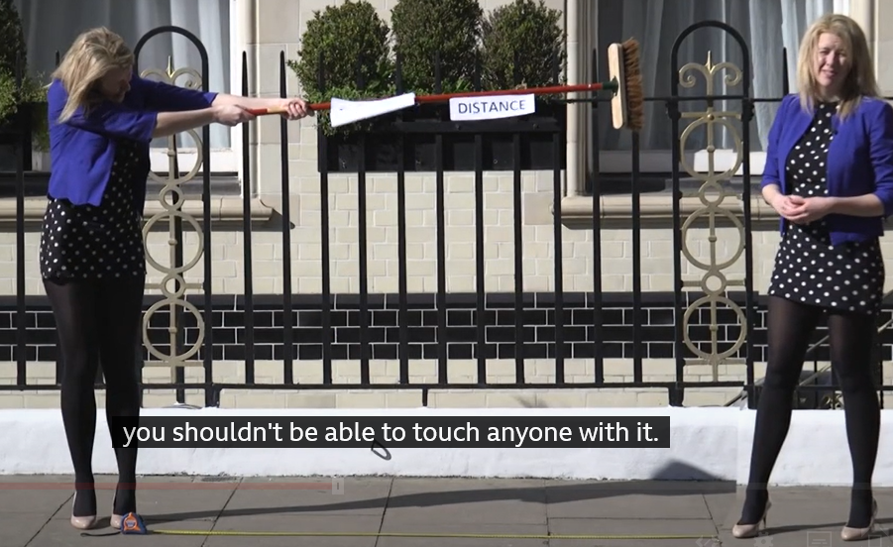
Or if you were holding a broom – you shouldn’t be able to touch anyone with it.

Slide 16
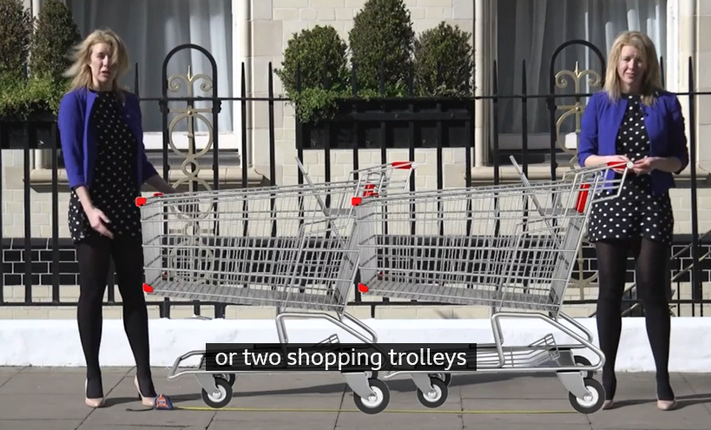
Or two shopping trolleys…

Slide 17
Or imagine an adult lying down…

Slide 18
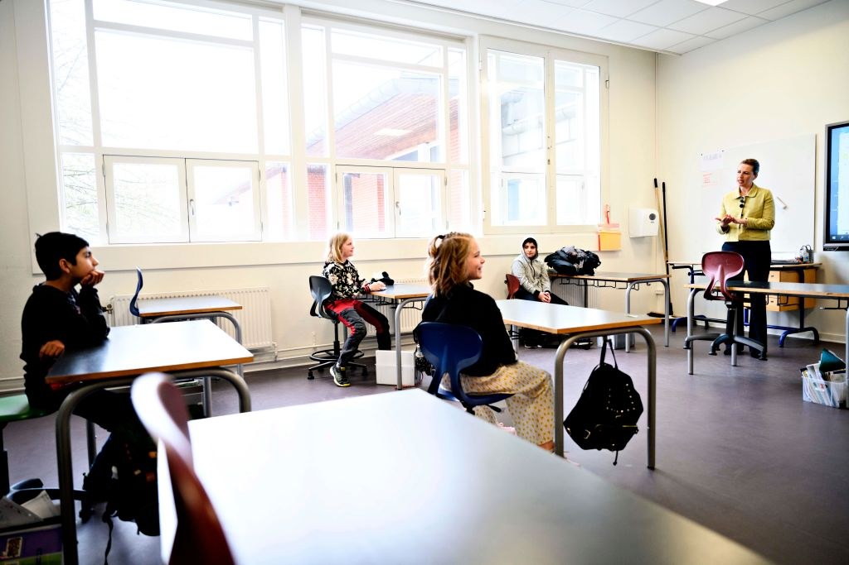
Our classes will have less children in so that we can try to stay further apart.
You may have less desks or they may be more spread out.

Slide 19
You will only be in classes of 15 students, so half of your class may be in another room.

Slide 20
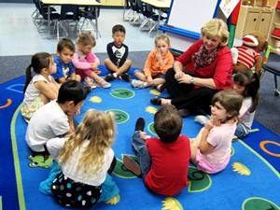
Your class group is your ‘bubble’ – this means you may get closer than 2 metres from them but should try to stay away from people from other bubbles.

Slide 21
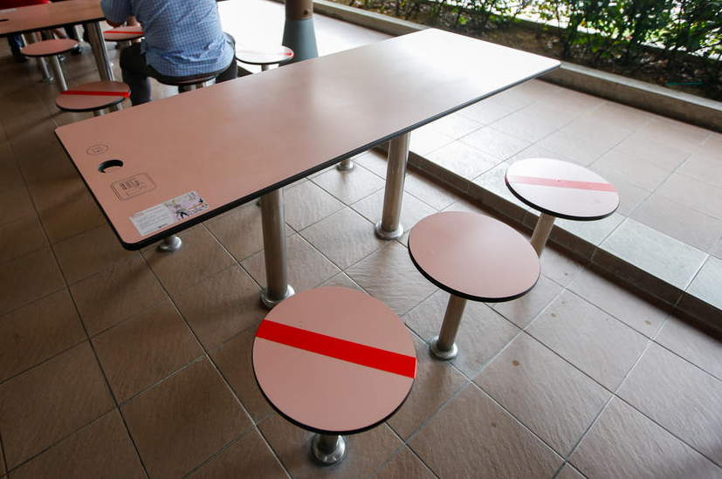
You may have a mark on your desk or chair so you know where to sit and where not to sit.
A red line or X means you shouldn’t sit there.

Slide 22
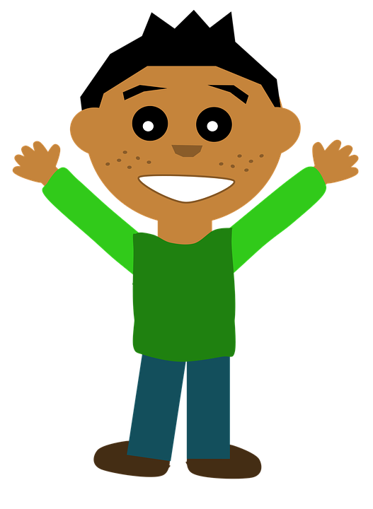
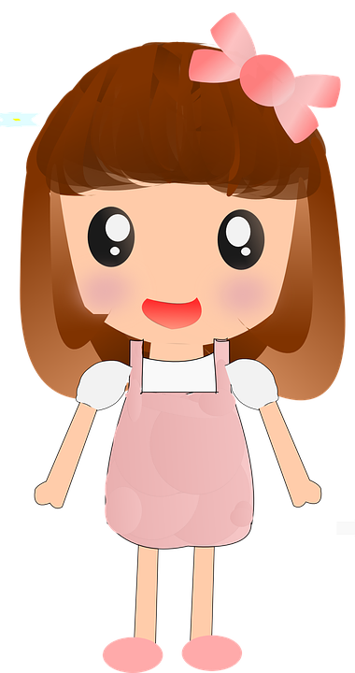
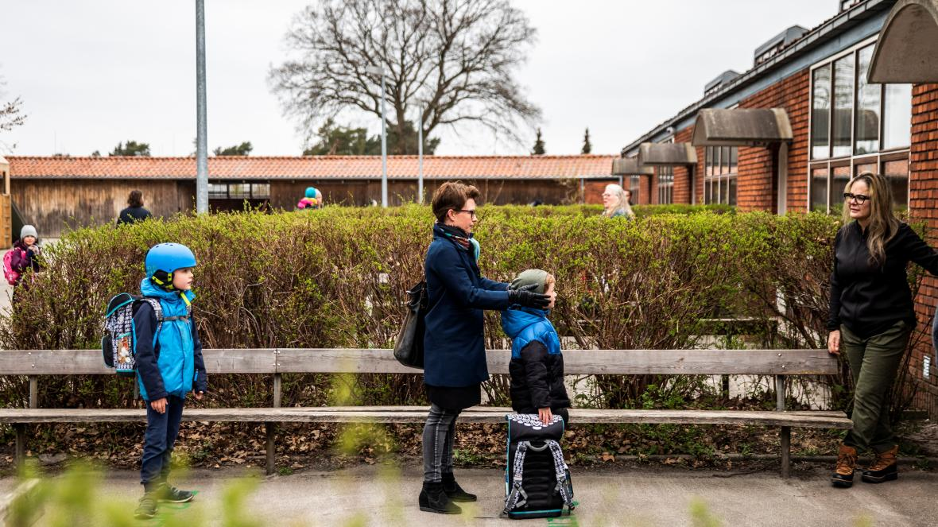
2 metres apart
2 metres apart
We used to all queue up close together. Now, if you are queuing to come into school, you will need to stand apart.

Slide 23
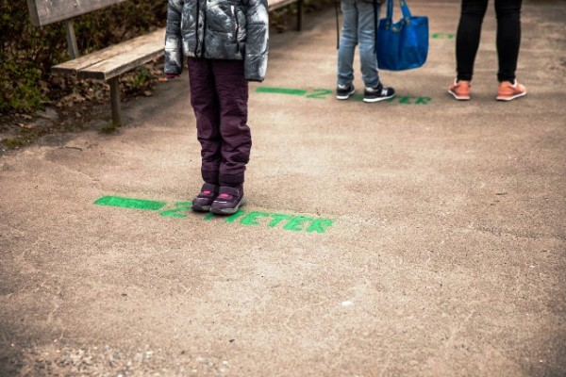
There may be marks on the ground showing you where to stand.

Slide 24
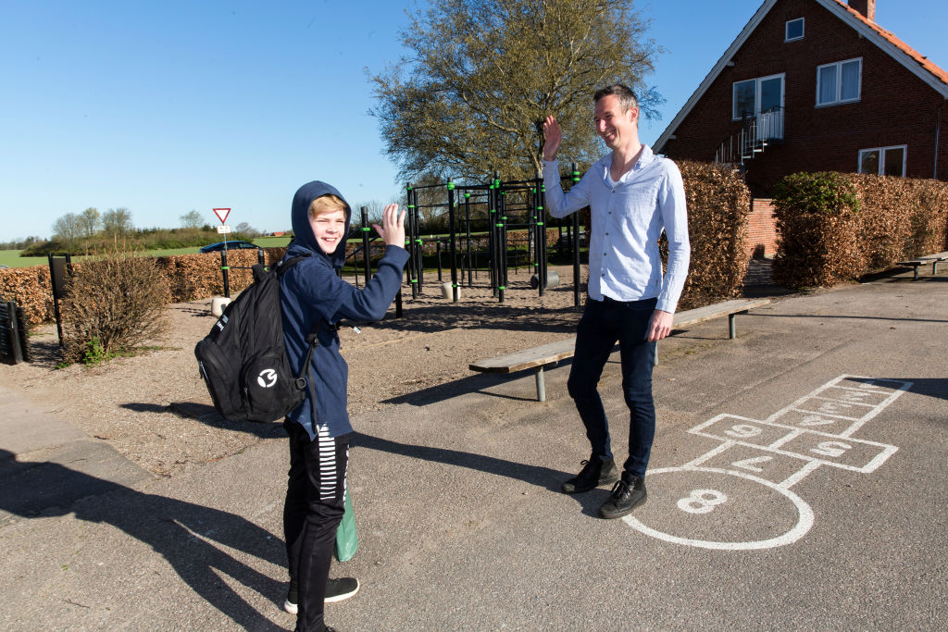
You may be excited to see your teachers or friends. You can greet them by waving from 2 metres away.

Slide 25
Your school may have new routines when you arrive.
You may have to use hand sanitiser as well as washing your hands.

Slide 26
If someone is coming towards you, you may need to move out of their way so they can walk past safely.
It’s OK if someone comes a bit too close – it is a guideline.

Slide 27
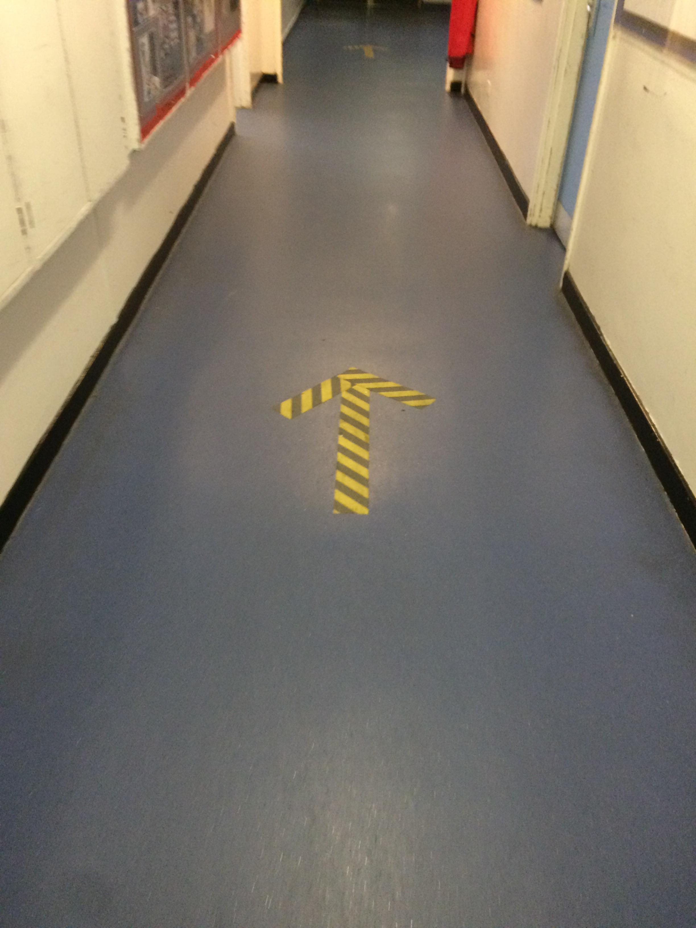
You may have a ‘one way’ system in corridors so you don’t pass anyone else.

Slide 28
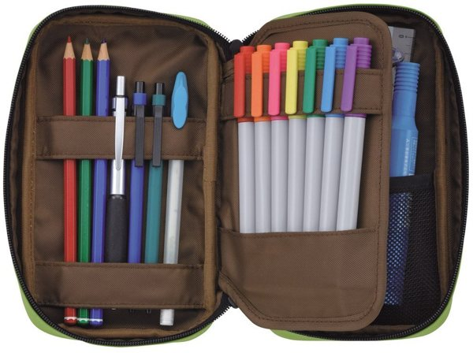
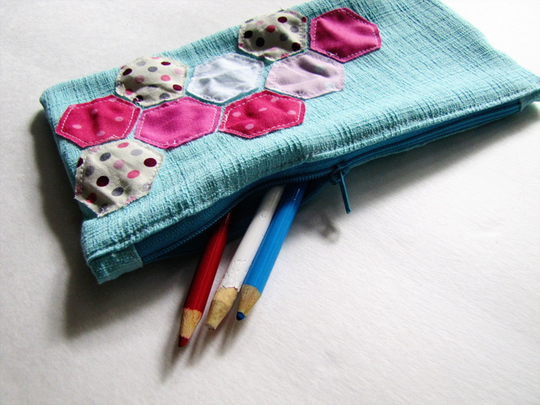
We must try not to touch other people or their things, so this means we need to have our own pencil case and water bottles.
We cannot share these things at the moment.

Slide 29
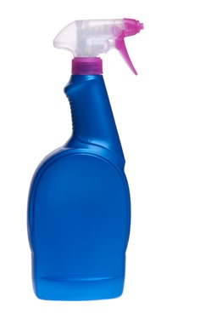
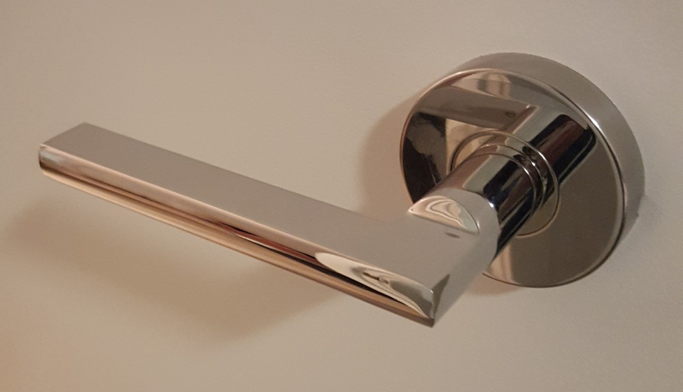
Lots of things will be washed and disinfected during the day and when you go home.
Things like door handles will be cleaned – this helps keep us safe.

Slide 30
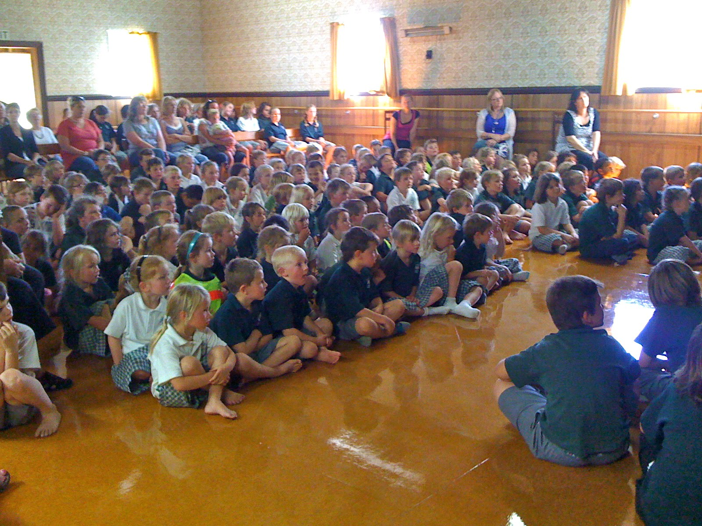
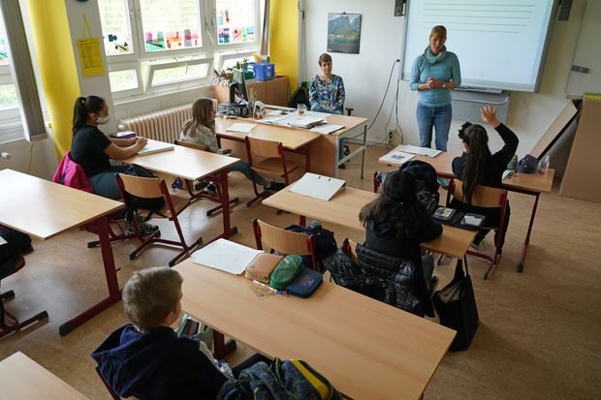
As gatherings are not allowed at the moment, we won’t have assembly as a big group in the hall but may meet as small group or via video link instead.

Slide 31
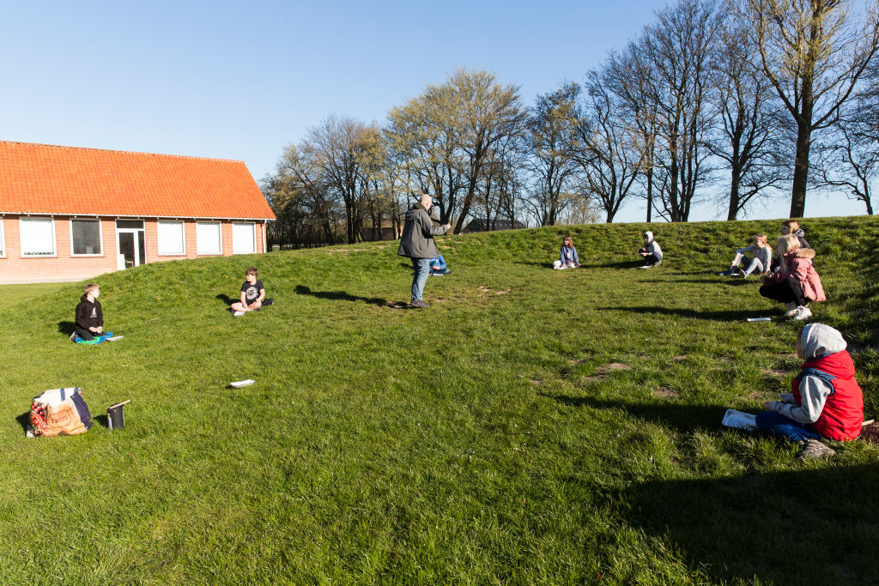
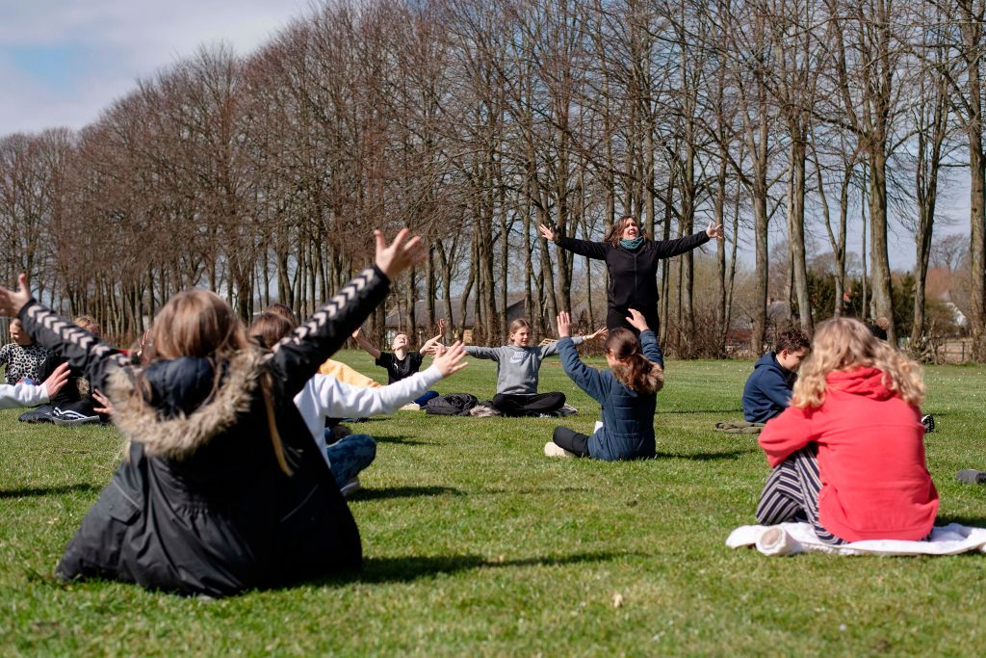
You may have some lessons outside, making sure you all keep apart.

Slide 32
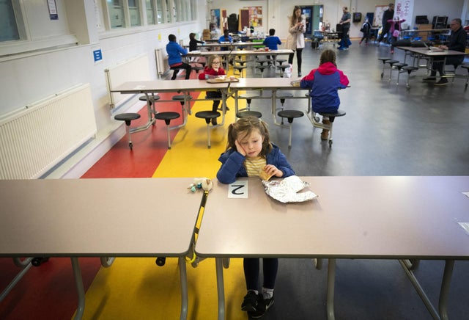
You may eat lunch in your classroom, or be spread out in the dinner hall.

Slide 33
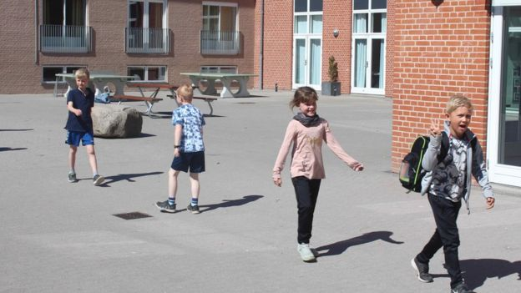
At break and playtimes, you may not be allowed any equipment out. You can play games but try to keep apart from anyone who is not in your ‘bubble’. Remember the bed rule!

Slide 34
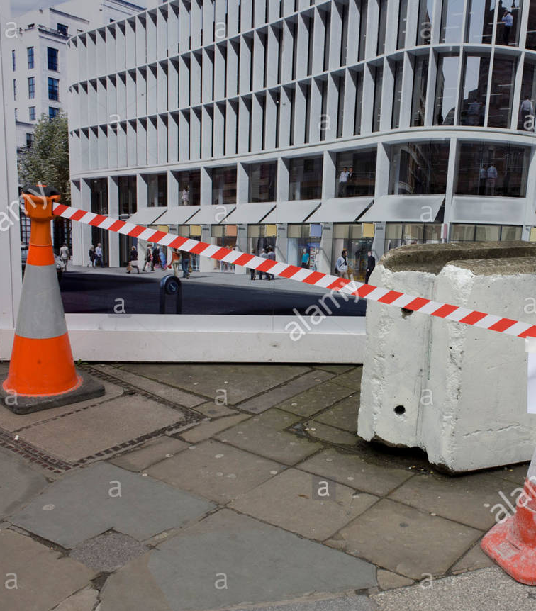
There may be some parts of the school where you are not allowed. These will be marked by tape on the floor or doors.

Slide 35
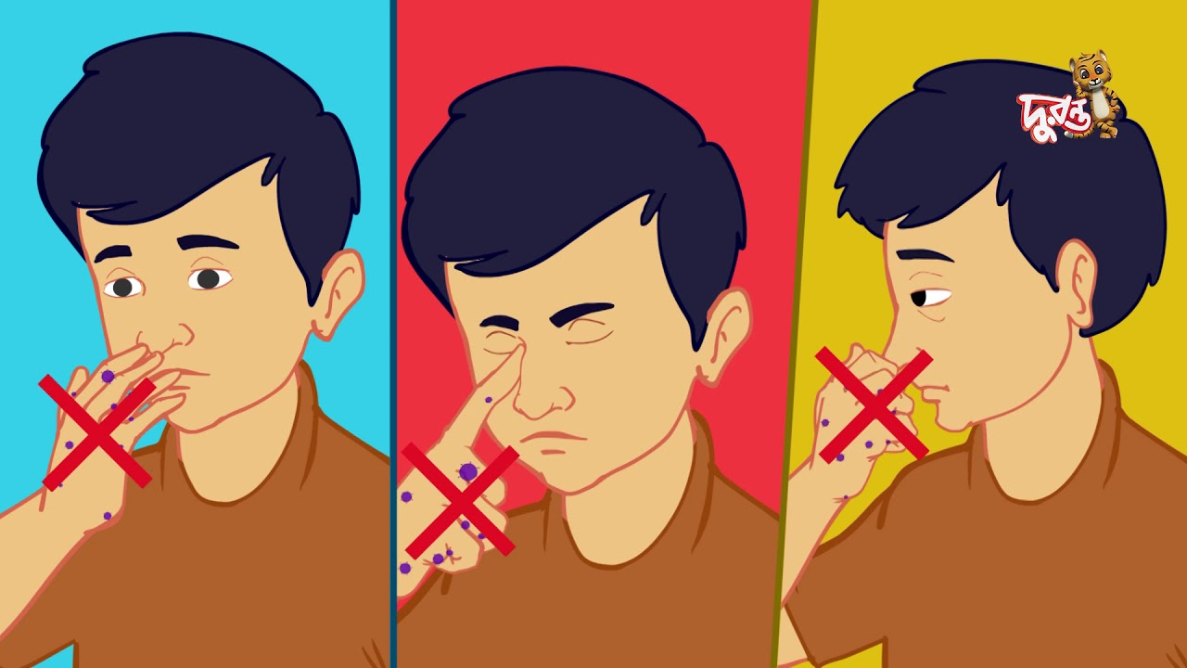
You should try and use tissues when you sneeze or cough and thrown it straight in the bin.
Try not to touch your mouth, nose and eyes with your hands

Slide 36
The best way to stay safe is to regularly wash your hands. This should be for at least 20 seconds.

Slide 37
You can sing the ‘happy birthday’ song in your head twice to know you have washed them for long enough.

Slide 38
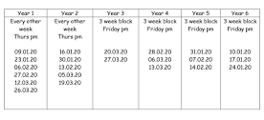
You may have a rota for when you can use the toilet so that all the children in the school can be kept safe.

Slide 39
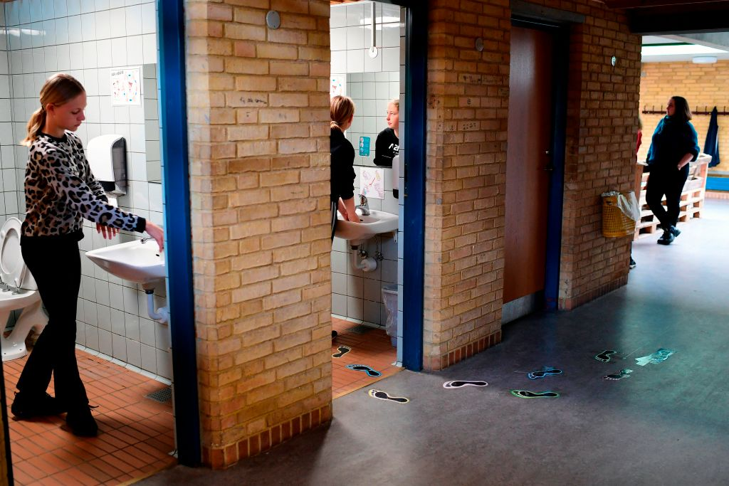
If someone is already in there, you may have to wait to use the toilet so that we can all keep a safe distance from each other.

Slide 40
We have some new school rules to keep us safe. These are:

Slide 41
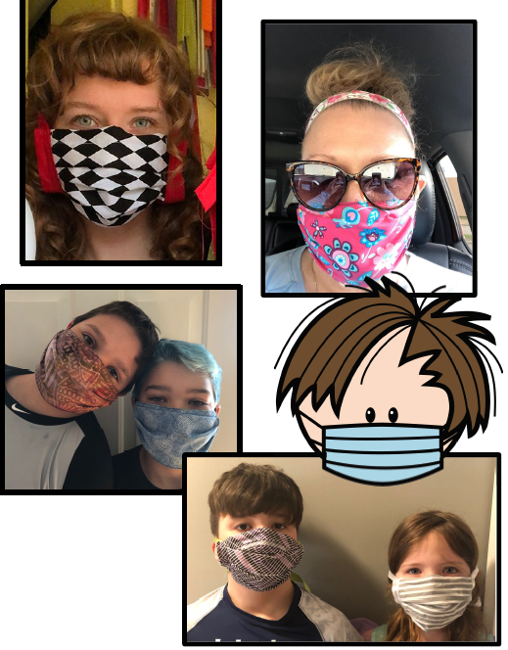
Some people may wear masks so that they don’t spread any bugs.
This may look different but its OK.

Slide 42
If you are feeling unwell, it is important to tell your teacher or parent as you may need to stay at home until you are better.

Slide 43
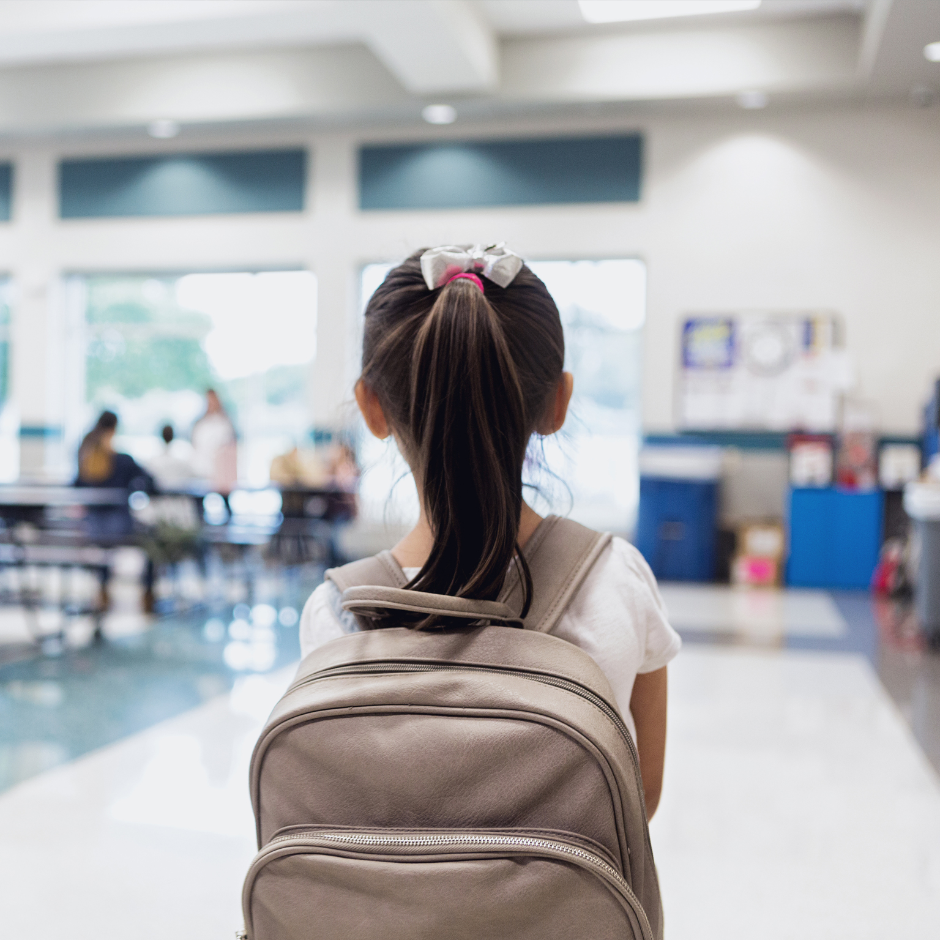
At the end of the day, you may be picked up from a different place.
You may have to wait – don’t worry, they are going to collect you.
XXXXX will collect you from the classroom.

Slide 44
What has stayed the same?

Slide 45
Lots of things will be the same in school:
You will see some of the same teachers
You will see some of your classmates
Your building will be in the same place
Your school uniform will be the same
Most of the school rules will stay the same

Slide 46
When will it go back to normal?

Slide 47
Doctors and researchers are working hard to find ways to make Covid-19 go away.
Once it is gone, we may be able to be closer to people at school again.

Slide 48
We don’t know how long this will take.
So for now we must keep each other safe by keeping 2 metres away as much as possible.

Slide 49
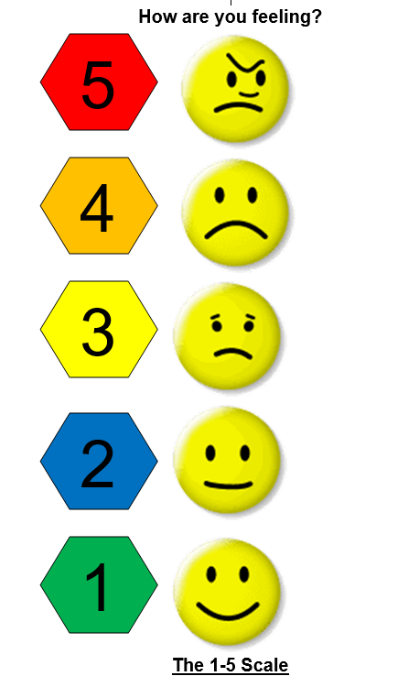
Lots of people are feeling worried at the moment.
You can always talk to your teacher or an adult in school about how you are feeling.

