Slide 1
Safeguarding Children and Vulnerable Adults with SEND
Hayley Cameron: Education Safeguarding Manager
Stephen Welding: E-Safety Adviser/Prevent Trainer
Gill Bush: Education Lead, CFCS
Mick Bradshaw: Outdoor Education Adviser
© Cognus Limited 2024

Slide 2
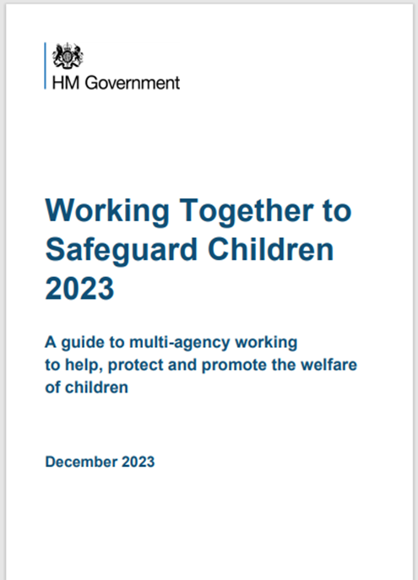
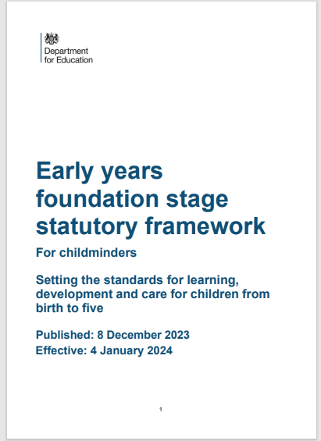
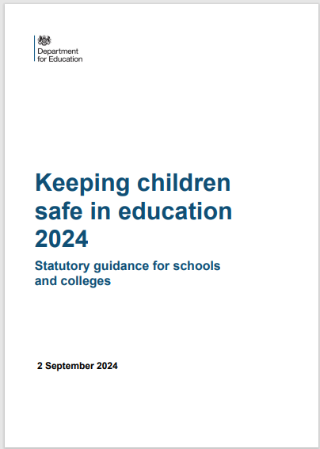
Legislation, Guidance and Procedure
Updated: 25th April 2024
Notes:
Read Keeping children safe in education (50 pages)

Slide 3
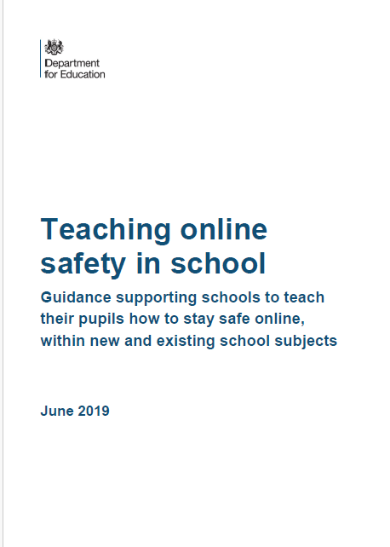
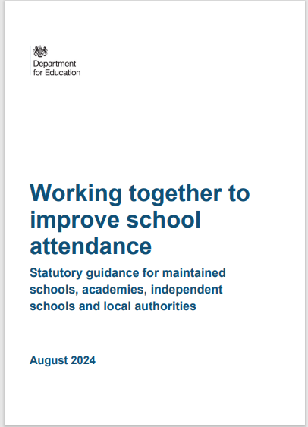
Key Guidance and Legislation

Slide 4
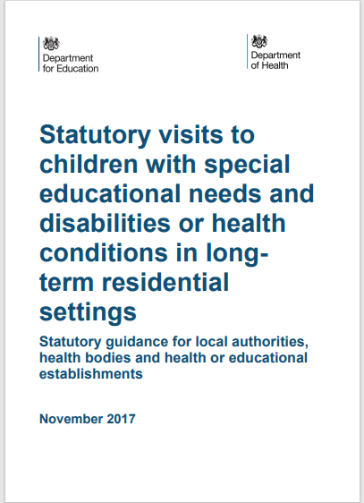
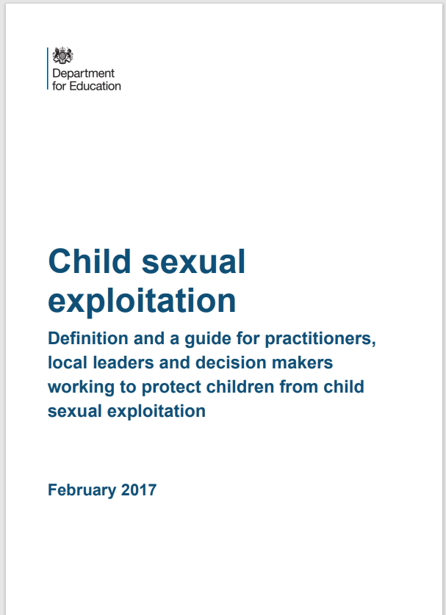
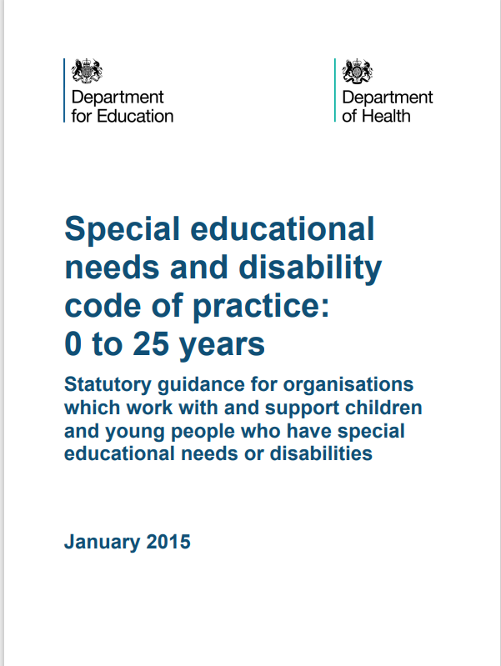
Key Guidance on Exploited Children

Slide 5
KCSIE 2024 – Safeguarding Definition
providing help and support to meet the needs of children as soon as problems emerge.
protecting children from maltreatment, whether that is within or outside the home, including online.
preventing impairment of children’s mental and physical health or development
ensuring that children grow up in circumstances consistent with the provision safe and effective care.
taking action to enable all children to have the best outcomes
Child Protection - Part of safeguarding and promoting welfare. This refers to the activity that is undertaken to protect specific children who are suffering, or are likely to suffer, significant harm.

Slide 6
UK Government definition of SEND
A child or young person has SEND if they have a learning difficulty or disability which calls for special educational provision to be made for him or her. A child of compulsory school age or a young person has a learning difficulty or disability if he or she has a significantly greater difficulty in
learning than the majority of others of the same age, or has a disability which prevents or hinders him or her from making use of educational facilities of a kind generally provided for others of the same age in mainstream schools or mainstream post-16 institutions.

Slide 7
KCSIE 2024 - Children with special educational needs, disabilities or health issues
Children with special educational needs or disabilities (SEND) or certain medical or physical health conditions can face additional safeguarding challenges both online and offline. Governing bodies and proprietors should ensure their child protection policy reflects the fact that additional barriers can exist when recognising
abuse, neglect and exploitation in this group of children.

Slide 8
What are special educational needs and disabilities?
Special educational needs and disabilities (SEND) is a term used to describe learning difficulties or disabilities that make it harder for a child or young person to learn compared to children of the same age.
A child may have SEND because of a diagnosed medical condition or a disability. Or they may have SEND without a diagnosis or disability.
A child may be identified as having special educational needs and disabilities early in their life or at the point they are diagnosed with a condition. Or it may not become obvious until they enter a later stage of their education.

Slide 9
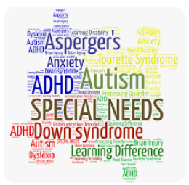
Specific Safeguarding Risks for Children with SEND
Increased vulnerability to abuse due to communication difficulties or dependence
Challenges in recognising and reporting abuse
Potential for over-medication or restraint
Risk of discrimination and exclusion

Slide 10
Key Safeguarding Issues
Abuse and Neglect:
Physical, emotional, sexual, neglectful abuse & exploitation
May be harder to identify due to communication barriers or difficulties in understanding boundaries.
Bullying and Peer Pressure:
SEND children may be more susceptible to bullying due to differences.
Ensure a supportive and inclusive environment.
Online Safety:
Educate SEND children about online risks and appropriate online behaviour.
Provide supervision and support

Slide 11
KCSIE – What are the Barriers when dealing with Children with SEND
Assumptions that indicators of possible abuse such as behaviour, mood and
injury relate to the child’s condition without further exploration
These children being more prone to peer group isolation or bullying (including
prejudice-based bullying) than other children
The potential for children with SEND or certain medical conditions being
disproportionately impacted by behaviours such as bullying, without outwardly
showing any signs
Communication barriers and difficulties in managing or reporting these challenges
cognitive understanding – being unable to understand the difference between fact
and fiction in online content and then repeating the content/behaviours in schools
or colleges or the consequences of doing so.

Slide 12
NSPCC - Misunderstanding the signs of abuse
It’s not always easy to spot the signs of abuse. In some cases, adults may mistake the indicators of abuse for signs of a child’s disability.
A child experiencing abuse or attempting to disclose abuse may display behaviours which are misinterpreted as part of a child’s disability or health condition rather than an indicator of abuse. This can prevent adults from taking action.
Injuries such as bruising may not raise the same level of concern as they would if seen on their peers. Adults may assume that bruising was self-inflicted or caused by disability equipment or problems with mobility.

Slide 13
NSPCC - Misunderstanding the signs of abuse
Children and young people with speech, language and communication needs (including those who are d/Deaf or have a learning disability or physical disability) face extra barriers when it comes to sharing their worries and concerns.
Adults may have difficulty understanding a child’s speech so they may not realise when a child is trying to tell them about abuse.
Adults may not have the knowledge, skills, equipment or resources to communicate with a child, which can make it harder for children to share their thoughts and feelings.
Relying on parents or carers to speak on behalf of their children may pose a risk if the child is being abused by their parent or carer.
Some children haven’t been taught the language they need to describe what’s happened to them. Without this education children can struggle to name and disclose concerns.

Slide 14
NSPCC - Lack of education on staying safe
d/Deaf children and children who have disabilities need to be taught about abuse as they may think that the abuse they are experiencing is ‘normal’, especially if they are isolated. Without this knowledge children may not recognise that they are being abused.
Personal safety programmes and relationships and sex education (RSE) are not always made accessible and are not always taught in specialist schools. This can be for a number of reasons:

Slide 15
NSPCC - Lack of education on staying safe
adults may not always know an appropriate and accessible way to teach children with communication needs about what about is or how to stay safe
lessons may not be taught in a way that makes sense to d/Deaf children or children who have disabilities. For example, there may be no facilities to include British Sign Language (BSL) or captions
parents and professionals may not think they need to, or may not think it is appropriate to, teach children who are d/Deaf or who have disabilities about sex, or relationships
teachers may feel they need more training about how to deliver lessons to children who are d/Deaf or who have disabilities
schools may not prioritise programmes being taught in a more accessible way
As a result, a d/Deaf child or a child who has a disability may not know how to recognise abuse or who to tell.

Slide 16
NSPCC - Increased isolation
Abuse and neglect are more likely to remain hidden when d/Deaf children and children who have disabilities do not have access to someone they trust.
d/Deaf children and children who have disabilities may have less contact with other people than their peers because they have:
fewer out of school opportunities and accessible events than their peers
fewer opportunities for spontaneous fun with friends
less access to transport

Slide 17
NSPCC - Increased isolation
d/Deaf children and children who have disabilities may also be isolated from the people they usually share their views and needs with if they live away from home in residential settings.
Placements far from home can make it difficult for family to visit regularly.
This means they may have fewer people to turn to if they need help or support.
The Child Safeguarding Practice Review Panel has set out learning and recommendations for keeping d/Deaf children and children who have disabilities safe in residential settings.

Slide 18
NSPCC - Dependency on others
d/Deaf children and children who have disabilities may have regular contact with carers and other adults for practical assistance in daily living including personal intimate care. This can increase the opportunity for an abusive adult to be alone with a child.
If a child is abused by a carer they rely on, they may be more reluctant to disclose abuse if they have been threatened by their perpetrator or are frightened that speaking out may lead to an end to the support they are receiving.

Slide 19
NSPCC - Lack of professional confidence or knowledge
A lack of skills, experience or understanding of a child’s disability can take focus away from the child’s experience and views. This can mean that safeguarding concerns are not recognised, and appropriate action is not taken.
Issues which can impact the effectiveness of professional practice include:
completing assessments that focus on needs relating to disability rather than looking at a child's wellbeing more holistically
not understanding or acknowledging the cultural aspects and complexities of being d/Deaf or having a disability
feeling overwhelmed or fearful or a child’s disability
relying on parents or carers to speak for their children, rather than communicating directly with children
believing that d/Deaf children and children who have disabilities don't experience abuse
assuming that a d/Deaf child or a child who has a disability will be an unreliable witness

Slide 20
NSPCC - Lack of appropriate support for children and their families
d/Deaf children, children who have disabilities and their families may have limited access to support systems due to lack of:
support in their local area that is appropriate for the child's physical, emotional or cultural needs
funding to access support.
Caring for a child with little or no support can put families under stress. This can make it difficult for parents and carers to provide the care their child needs and this may result in their children being at risk of harm.

Slide 21
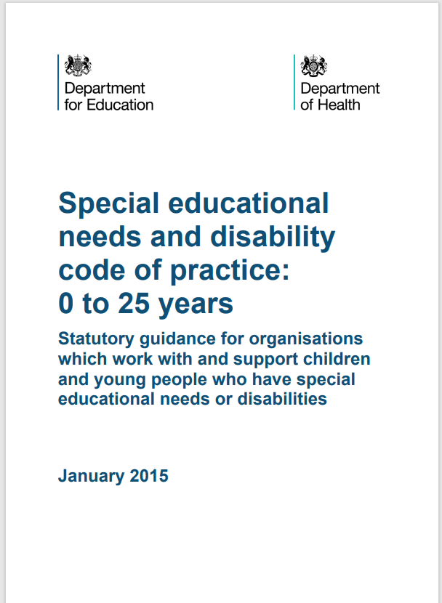
KCSIE – Advice and Support for SEND pupils
Any reports of abuse involving children with SEND will therefore require close liaison with the designated safeguarding lead (or a deputy) and the special educational needs coordinator (SENCO) or the named person with oversight for SEND in a college.
Schools and colleges should consider extra pastoral support and attention for these children, along with ensuring any appropriate support for communication is in place.

Slide 22
Child criminal exploitation
As set out in the Serious Violence Strategy, published by
the Home Office, where an individual or group takes advantage of an imbalance of power to coerce, control, manipulate or deceive a child or young person under the age of 18 into any criminal activity (a) in exchange for something the victim needs or wants, and/or (b) for the financial or other advantage of the perpetrator or facilitator and/or (c) through violence or the threat of violence. The victim may have been criminally exploited even if the activity appears consensual. Child criminal exploitation does not always involve physical contact; it can also occur through the use of technology.

Slide 23
Child sexual exploitation
Child sexual exploitation is a form of child sexual abuse. It
occurs where an individual or group takes advantage of an imbalance of power to coerce, manipulate or deceive a child or young person under the age of 18 into sexual activity (a)
in exchange for something the victim needs or wants, and/or (b) for the financial advantage or increased status of the perpetrator or facilitator. The victim may have been sexually exploited even if the sexual activity appears consensual. Child sexual exploitation does not always involve physical contact; it can also occur through the use of technology.

Slide 24
Criminal exploitation of children, young people and vulnerable adults
Some of the factors that may heighten a person’s vulnerability include:
having experience of neglect, physical abuse, sexual abuse /exploitation or a lack of a safe/stable home environment, now or in the past.
social isolation or social difficulties – the lack of a support network can mean someone is less able to get help.
having a physical or learning disability, or being neurodivergent – victims may be less able to recognise they are being exploited, or less able to communicate it or access support
having mental health issues – exploiters may target poor emotional wellbeing or low self-esteem

Slide 25
Criminal exploitation of children, young people and vulnerable adults
being in or leaving care – the context behind why a person is brought into care can heighten a person’s vulnerability in itself, while those in semi-independent/independent accommodation, placed out-of-area or leaving care may have less access to support networks;
being excluded from mainstream education, and/or a pupil at an alternative provision such as a pupil referral unit – factors influencing a child’s exclusion may indicate they are exposed to exploitation, while being disengaged from meaningful activity and peers can evoke feelings of disenfranchisement and, for those with a reduced timetable or not attending school at all, time spent unsupervised can offer opportunities for exploitation;

Slide 26
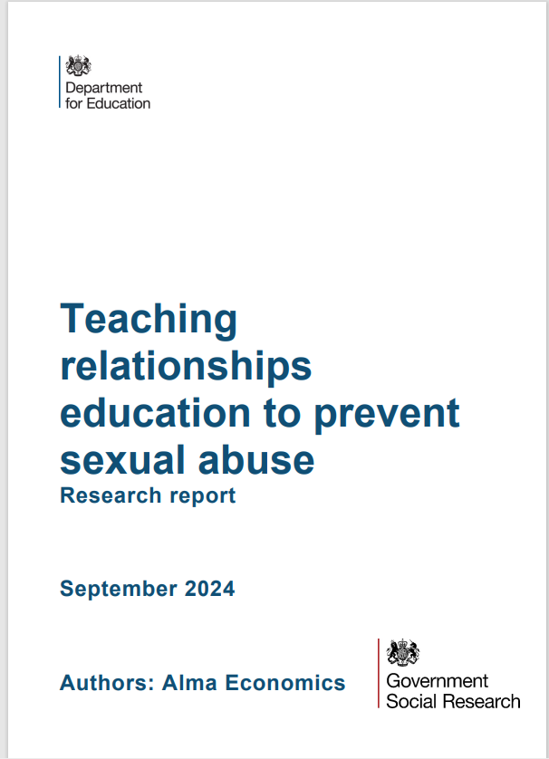
Teaching Relationships education
Regarding students with SEND, it is noted that additional resources and further support should be provided for their teaching. Collaborations with other relevant organisations and professionals (such as care organisations, sexual services and specialist health services) can prove useful to better identify the needs of these young people and tailor
the curriculum to them (McCann et al., 2019)

Slide 27
Teaching Relationships education
Systematic collection of evidence shows that families of adolescents and young people with SEND tend to be worried (though not always and not all of them) that if they become sexually active this will pose a risk to their safety and may result in abuse or another form of harm (McCann et al., 2019). McCann et al (2019) stressed that this further intensifies their need for accessing sex and relationships education, but teachers should be trained to address their families’ concerns or disagreements, primarily by highlighting the ability of people with SEND to consent to sexual activities as well as the positive impact relevant education can have on their lives.

Slide 28
Teaching Relationships education
Finally, the literature review conducted by McCann et al (2019) showed that there are wider benefits for pupils with SEND who are effectively included in the RSE curriculum, such as: boosting their self-esteem, developing positive feelings and better knowledge of issues related to their sexuality as well as their personal safely, and informing their decision-making capacity, especially in areas related to consent and personal boundaries.

Slide 29
Appropriate Language in Relation to Child Exploitation
It is imperative that appropriate terminology is used when discussing children and young people who have been exploited or are at risk of exploitation. Language implying that the child or young person is responsible in any way for abuse and crime that they are subjected to, must be avoided to ensure we safeguard them appropriately. It is also important to recognise that a child cannot consent to their own exploitation.

Slide 30
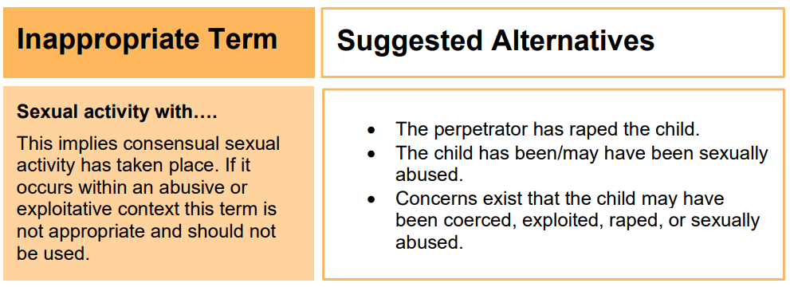
Appropriate Language in Relation to Child Exploitation

Slide 31
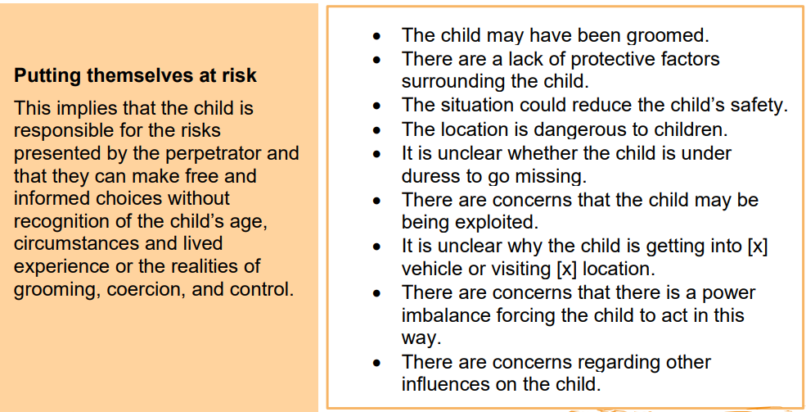
Appropriate Language in Relation to Child Exploitation

Slide 32
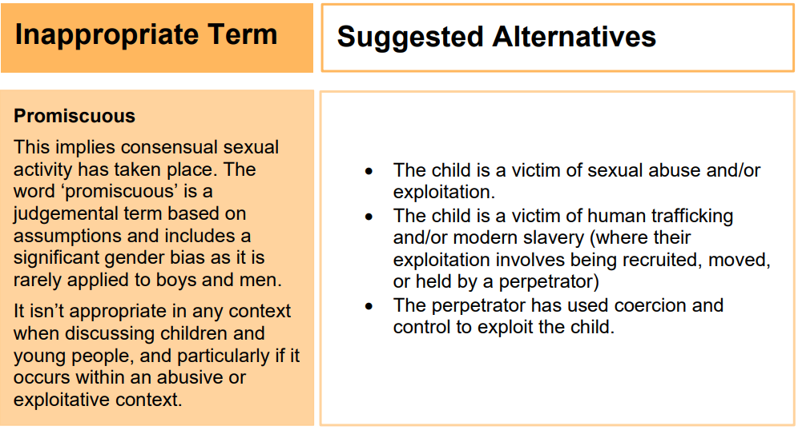
Appropriate Language in Relation to Child Exploitation

Slide 33
Appropriate Language in Relation to Child Exploitation

Slide 34
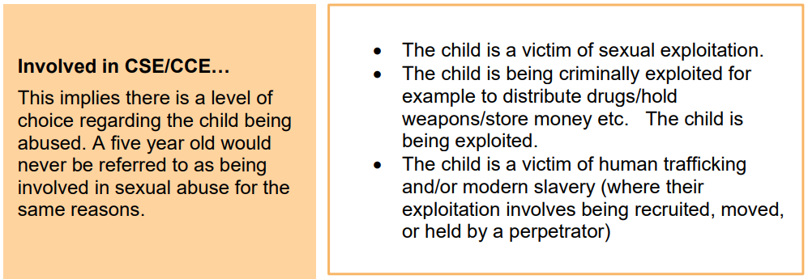
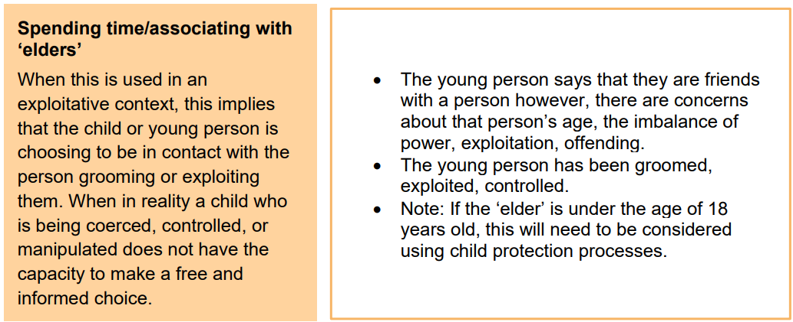
Appropriate Language in Relation to Child Exploitation

Slide 35
Specialist organisations:
The Special Educational Needs and Disabilities Information and Support Services (SENDIASS). SENDIASS offer information, advice and support for parents and carers of children and young people with SEND. All local authorities have such a service:
https://councilfordisabledchildren.org.uk/about-us-0/networks/information-advice-and-support-services-network/find-your-local-ias-service
https://www.mencap.org.uk/ - Mencap Training Academy is delivering supported internships to people aged 16-24 with a learning disability, to make the transition from education into work
https://learning.nspcc.org.uk/safeguarding-child-protection-schools/safeguarding-children-with-special-educational-needs-and-disabilities-send - NSPCC Safeguarding children with special educational needs and disabilities (SEND)

Slide 36
Additional Resources:
https://www.nspcc.org.uk/Mencap: https://www.mencap.org.uk/Autism UK: https://www.autism.org.uk/Department for Education: https://www.gov.uk/government/organisations/department-for-education
https://www.ceopeducation.co.uk/
https://www.internetmatters.org/inclusive-digital-safety/

Slide 37
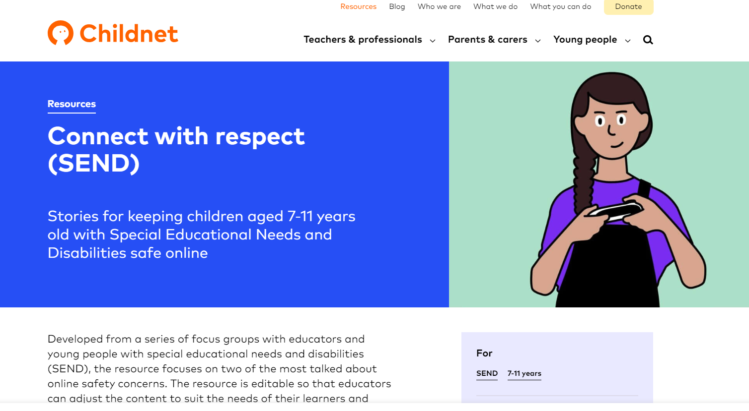
https://www.childnet.com/

Slide 38
Sutton Local Safeguarding Children’s Partnership (LSCP)
The “Go To” place for Safeguarding Advice
www.suttonlscp.org.uk

Slide 39
Sutton - SEND Local Offer

Slide 40
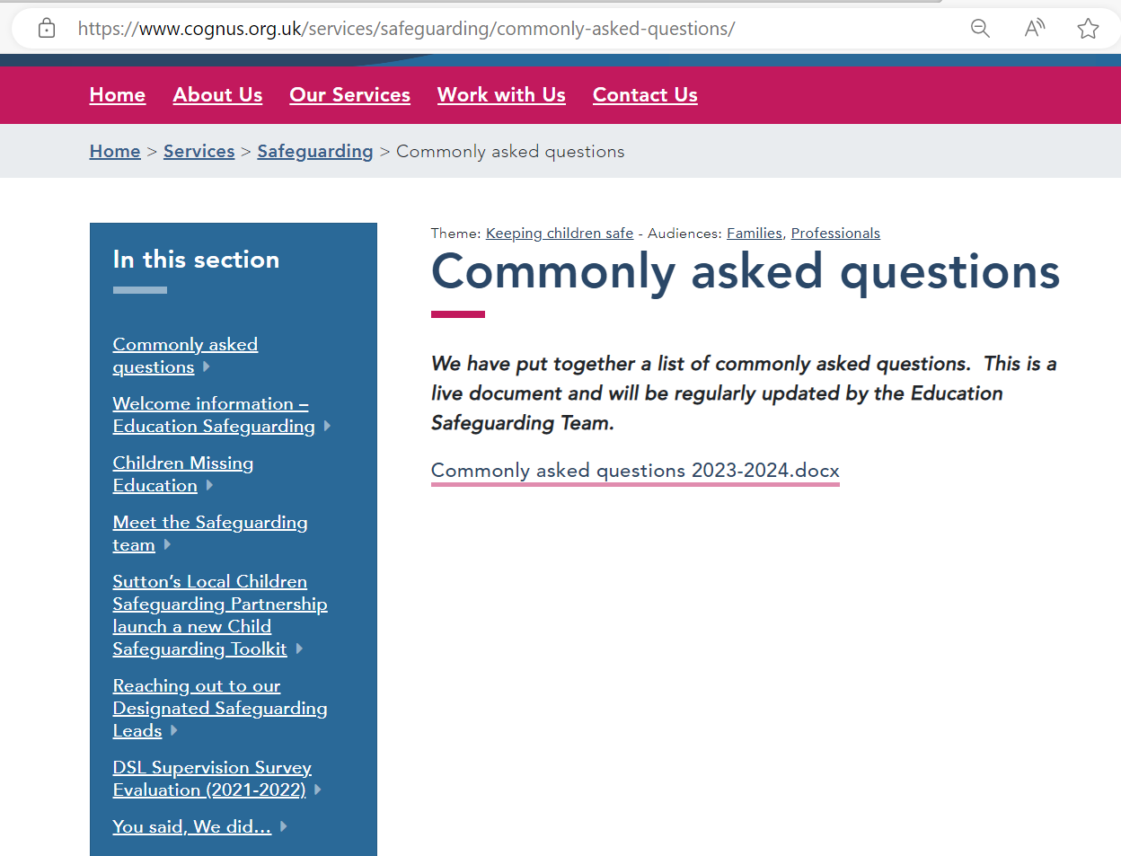
WWW.COGNUS.ORG.UK

Slide 41
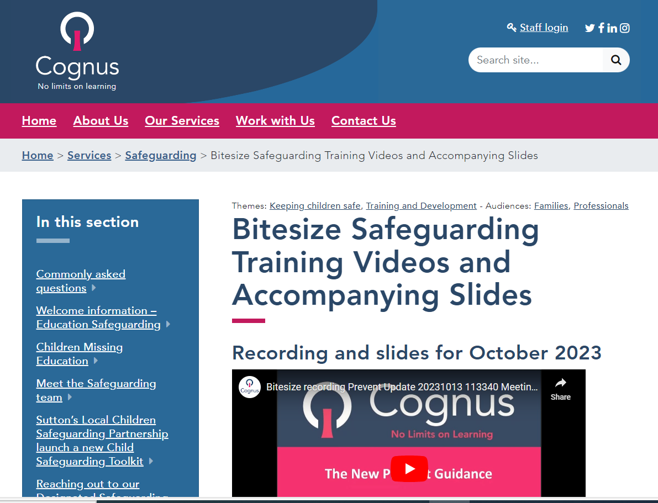
Bitesize training on the Cognus Website

Slide 42
Cognus Safeguarding Team
CFCS – 0208 770 6001
Out of Hours 0208 770 5000
cfcs@sutton.gov.uk
Joanna.cassey@cognus.org.uk (Cognus DSL)
hayley.cameron@cognus.org.uk (Cognus DDSL)
stephen.welding@cognus.org.uk
gillian.bush@cognus.org.uk
mick.bradshaw@cognus.org.uk
Nick.Banham@cognus.org.uk – Early Years Adviser
117

Slide 43
Thank You for Listening
Bitesize training & Podcast on Cognus website
Hayley Cameron: Education Safeguarding Manager
Stephen Welding: Esafety Adviser/Prevent Trainer
Gill Bush: Education Lead, CFCS
Mick Bradshaw: Outdoor Education Adviser
© Cognus Limited 2024

